Slide 1
Weekly Update – Password Manager
Mario Getaw, Joshua Moore, Jarrett Wilson

Slide 2
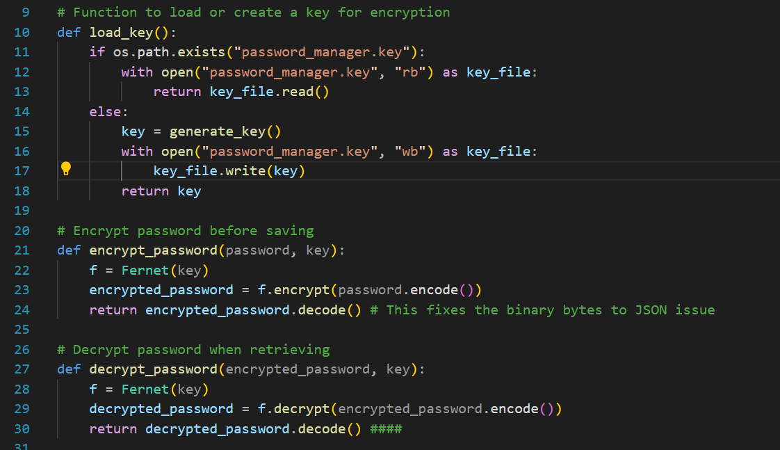
Encryption Code

Slide 3
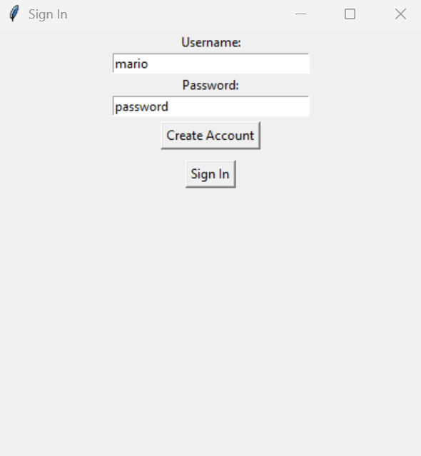
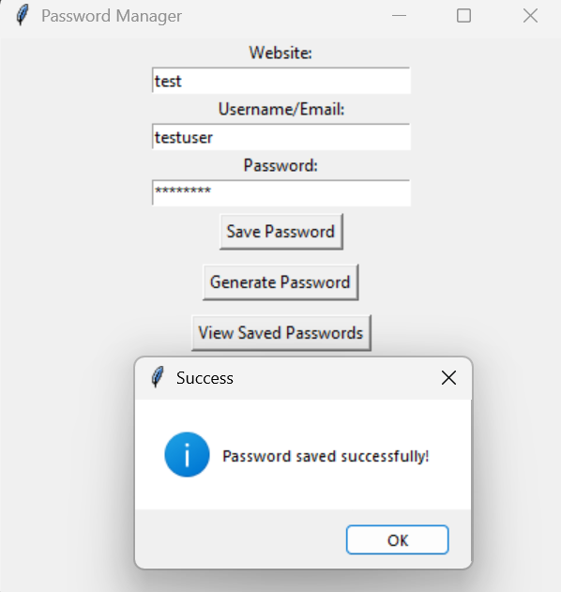
Results

Slide 4
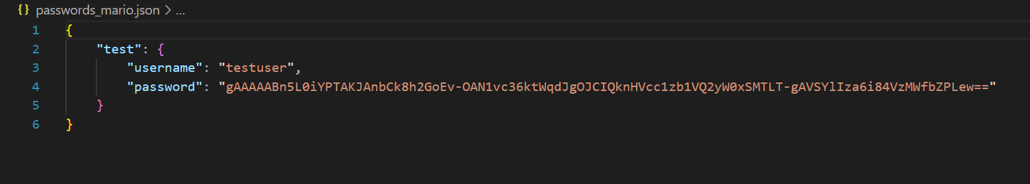
Results Continued

Slide 5
Schedule
Week 3 (1/30) - Research secure password management practices and encryption methods
Week 4 (2/6) - Compile research findings and outline code
Week 5 (2/13) - Create the GUI for the application
Week 6 (2/20) - Create a login for users to view their saved passwords
Week 7 (2/27) - Write code to ensure all passwords meet the specifications above
Week 8 (3/6) • F.I.RE Week
Week 9 (3/13) • Spring break
Week 10 (3/20) - Create a method for storing user data
Week 11 (3/27) - Implement data encryption
Week 12 (4/3) - Add password strength analysis
Week 13 (4/11) - Test project
Week 14 (4/18) - Create a project presentation
Week 15 (4/25) Present project

Slide 6
Next Steps To Wrap off This Weeks Goal
Securely allow the user to view their plaintext password
Encrypt the actual password for the account
Make JSON file secure and not named password
Move to next weeks scheduled goal – password strength analysis

